Slide 1

Macro
Prima
LIQUID CALCIUM WITH ORGANIC CARBON
Calcium where
roots need it.
Targeted liquid calcium for in-furrow, deep
placement and fertigation programs.
62 g/L
CALCIUM
With organic carbon
Supplies calcium to increase calcium saturation of the soil's cation exchange capacity (CEC), supporting
displacement of exchangeable aluminium in acidic soils and sodium in sodic soils.
Place it with purpose
Concentrate calcium in the zone targeted by your seeding,
deep-placement or irrigation system.
Support soil exchange
Supply calcium that can occupy exchange sites on clay and organic
matter.
Match the soil constraint
Use soil testing to guide calcium nutrition and the management of
acidic or sodic root zones.
Plan the zone. Then choose the rate.
Row spacing, placement width, depth and soil type determine local concentration. Explore your application
scenario with the MacroPrima field guide and calculator.
wilchem.com.au
OCT 2026 | 1 / 3

Slide 2
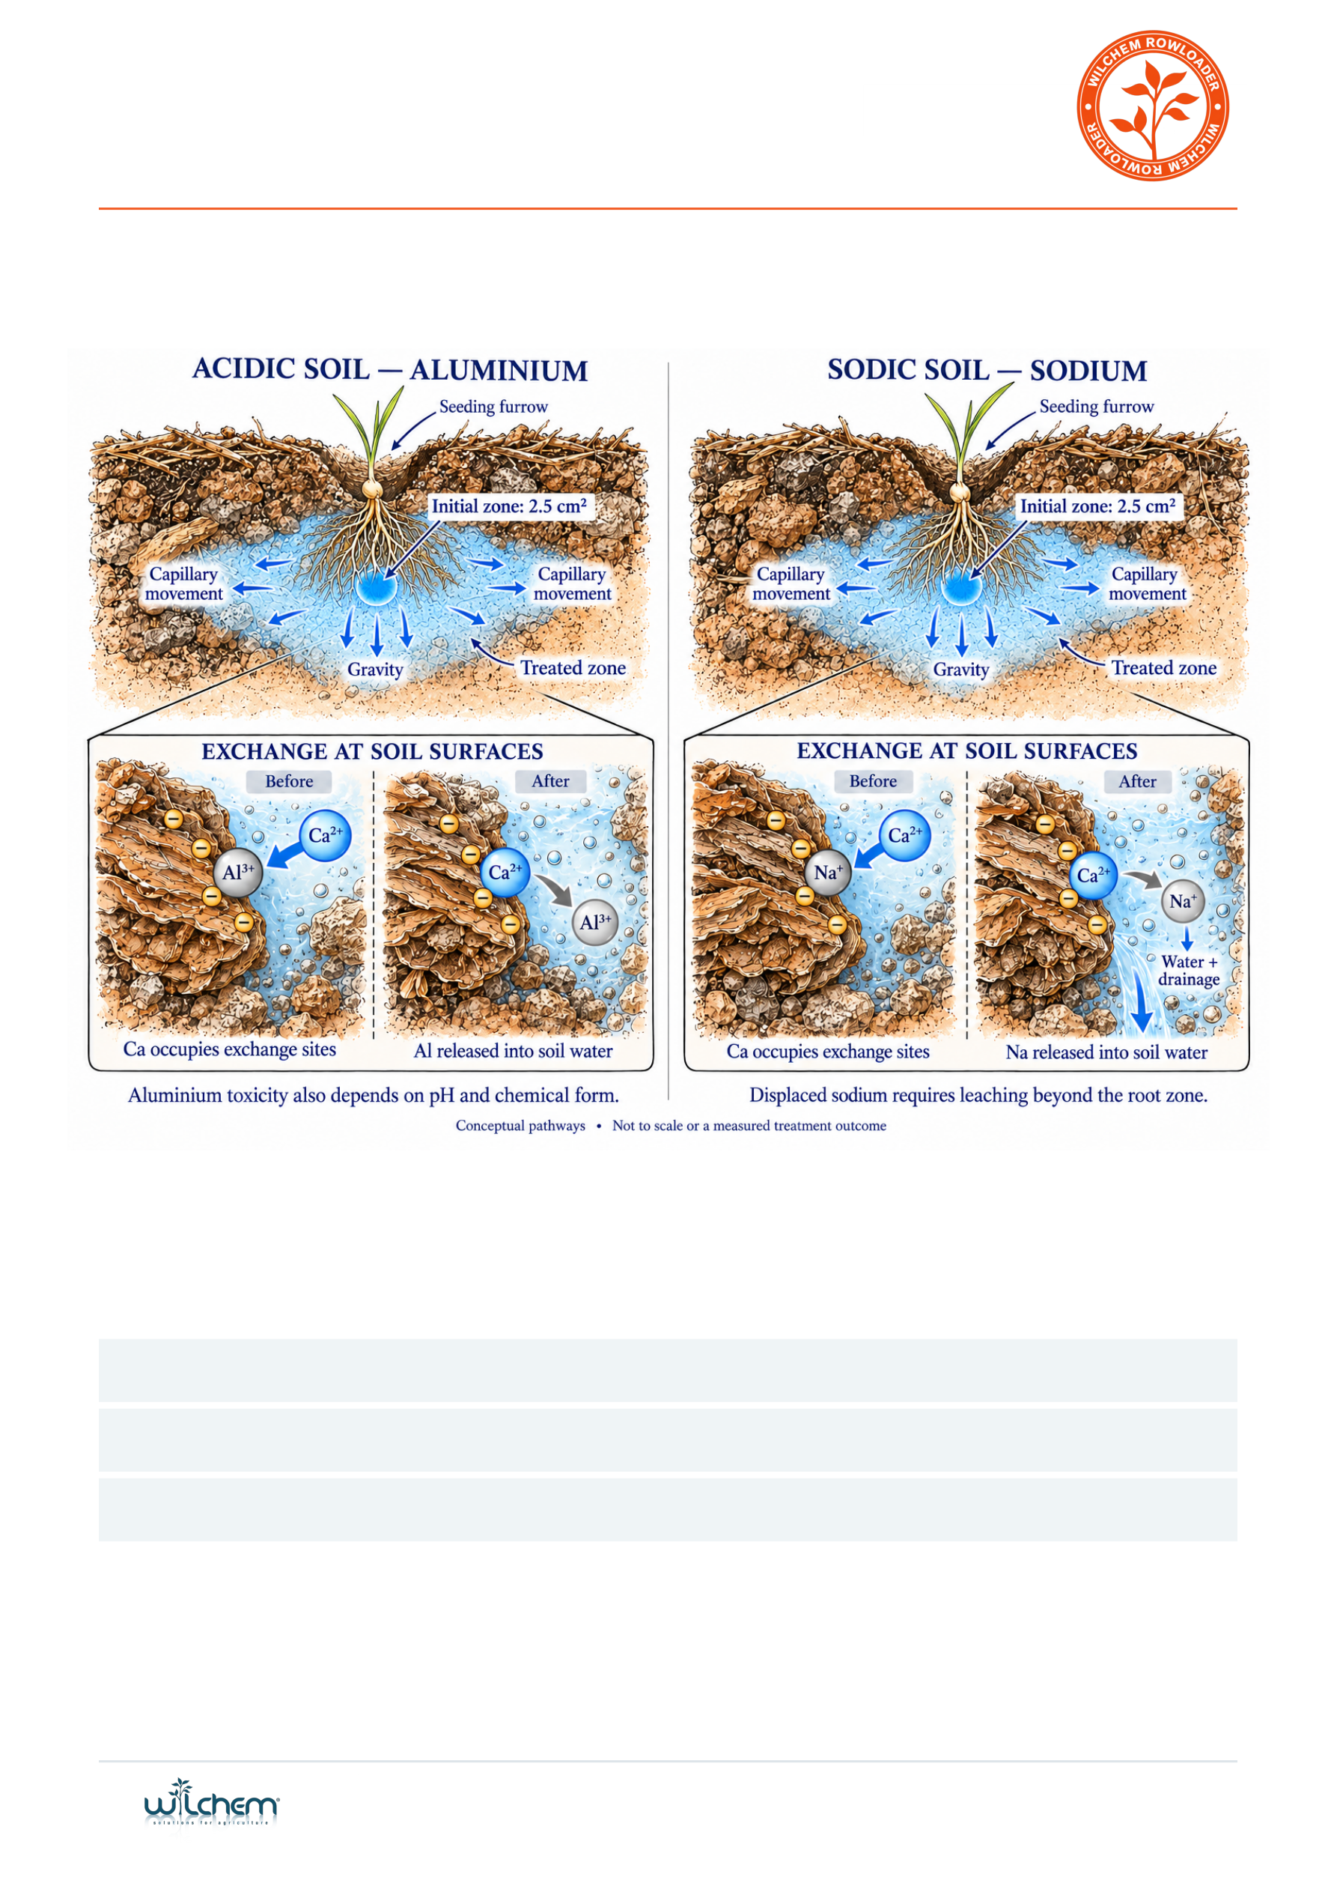
Macro
Prima
LIQUID CALCIUM WITH ORGANIC CARBON
Placement. Movement. Exchange.
The illustrated 2.5 cm² starting zone is a cross-sectional area. Water movement spreads the applied solution; the actual treated
footprint varies with soil structure, moisture and water volume.
Application guide
Broadacre in-furrow
4-8 L/ha
Deep placement
20-40 L/ha
Fertigation
100 L per 1,000 L irrigation water
Fertigation is a mixing ratio; determine the total product rate for the irrigated area. Confirm suitability, dilution and mixing with current label, SDS
and compatibility guidance.
Use within a soil-tested program. Calcium exchange alone does not establish aluminium detoxification or lime equivalence. Displaced sodium
requires water and drainage. The illustration shows conceptual pathways, not a measured treatment response.
wilchem.com.au
OCT 2026 | 2 / 3

Slide 3

APPLICATION PARTNERS
Macro
Prima
Through your planter.
BROADACRE IN-FURROW
DEEP PLACEMENT
MacroPrima 4-8 L/ha
MacroPrima 20-40 L/ha
Target the planned root-zone band.
Place into the identified soil constraint.
EXPLORE THE WILCHEM RANGES & SERVICES
Adjuvants
Rowloader
Signature
Sulfate
Spray application aids
Nutrients & soil conditioners
Amino acid chelates
Liquid sulfate trace elements
Biotics
Sentinel
Crop Manager
Measure • Monitor • Manage
Biological solutions
EDTA chelates
Crop monitoring
Inform crop decisions
Confirm equipment suitability, dilution and placement with your adviser.
For product guidance: wilchem.com.au | Equipment: furrowmsa.com.au
MACROPRIMA | WILCHEM ROWLOADER RANGE
3 / 3

